Slide 1
Git VS SVN

Slide 2
Git
Git is a distributed revision control and source code management system with an emphasis on speed, is a free software distributed under the terms of the GNU General Public License version .
Advantages of Git
1. Free and open source:
Git is released under GPL’s open source license. It is available freely over the internet.
2. Fast and small:
there are multiple copies of it, data present on any client side mirrors the repository,
hence it can be used in the event of a crash or disk corruption.
3. Implicit backup :
The chances of losing data are very rare when there are multiple copies of it.
Data present on any client side mirrors the repository, hence it can be used in the event of a
crash or disk corruption.

Slide 3
Distributed Version Control System
Git falls under distributed version control system, clients not only check out the latest snapshot of the directory but they also fully mirror the repository. If the server goes down, then the repository from any client can be copied back to the server to restore it. Every checkout is a full backup of the repository. Git does not rely on the central server and that is why you can perform many operations when you are offline. You can commit changes, create branches, view logs, and perform other operations when you are offline. You require network connection only to publish your changes and take the latest changes.

Slide 4
DVCS Terminologies
Local Repository
Every VCS tool provides a private workplace as a working copy. Developers make
changes in their private workplace and after commit, these changes become a part of
the repository. Git takes it one step further by providing them a private copy of the
whole repository. Users can perform many operations with this repository such as add
file, remove file, rename file, move file, commit changes, and many more.
Working Directory and Staging Area
The working directory is the place where files are checked out. Git doesn’t track each
and every modified file. Whenever you do commit an operation, Git looks for the files
present in the staging area. Only those files present in the staging area are considered
for commit and not all the modified files.
Blobs
Blob stands for Binary Large Object. Each version of a file is represented by blob. A
blob holds the file data but doesn’t contain any metadata about the file. In Git, files
are not addressed by names. Everything is content-addressed

Slide 5
DVCS Terminologies
Trees
Tree is an object, which represents a directory. It holds blobs as well as other sub
directories. A tree is a binary file that stores references to blobs and trees
Commits
Commit holds the current state of the repository. You can consider a commit
object as a node of the linked list. Every commit object has a pointer to the parent
commit object. From a given commit, you can traverse back by looking at the
parent pointer to view the history of the commit. If a commit has multiple parent
commits, then that particular commit has been created by merging two branches.
Branches
Branches are used to create another line of development. By default, Git has a
master branch. Usually, a branch is created to work on a new feature. Once the
feature is completed, it is merged back with the master branch and we delete the
branch. Every branch is referenced by HEAD, which points to the latest commit in
the branch. Whenever you make a commit, HEAD is updated with the latest
commit.

Slide 6
DVCS Terminologies
Tags
Tag assigns a meaningful name with a specific version in the repository. Tags are very similar
to branches, but the difference is that tags are immutable. It means, tag is a branch, which
nobody intends to modify. Once a tag is created for a particular commit, even if you create a
new commit, it will not be updated. Usually, developers create tags for product releases.
Clone
Clone operation creates the instance of the repository. Clone operation not only checks
out the working copy, but it also mirrors the complete repository. Users can perform many
operations with this local repository. The only time networking gets involved is when the
repository instances are being synchronized.
Pull
Pull operation copies the changes from a remote repository instance to a local one. The pull
operation is used for synchronization between two repository instances. This is same as the
update operation in Subversion.

Slide 7
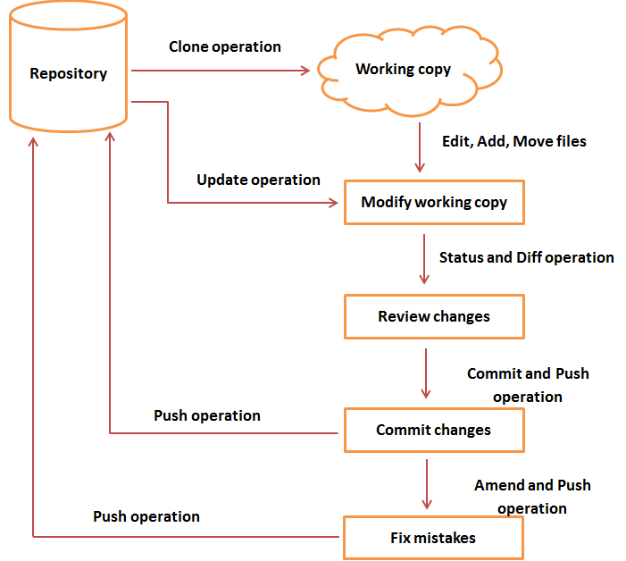
Life Cycle

Slide 8
SVN
Apache Subversion which is often abbreviated as SVN, is a software versioning and revision control system distributed under an open source license. Subversion falls under centralized version control system, meaning that it uses central server to store all files and enables team collaboration.
Advantages of SVN
1. Single repository
Subversion only supports a single repository there is little doubt about where something is stored. Once a
user knows the repository URL they can reasonably assume that all materials and all branches related to that
project are always available at that location.
2. Access Control
Since Subversion has a single central repository it is possible to specify read and write access
controls in a single location and have them be enforced across the entire project.

Slide 9
SVN Terminologies
Repository
A repository is the heart of any version control system. It is the central place where
developers store all their work. Repository not only stores files but also the history.
Repository is accessed over a network, acting as a server and version control tool acting as
a client. Clients can connect to the repository, and then they can store/retrieve their
changes to/from repository. By storing changes, a client makes these changes available to
other people and by retrieving changes, a client takes other people's changes as a working
copy.
Trunk
The trunk is a directory where all the main development happens and is usually checked out
by developers to work on the project.
Tags
The tags directory is used to store named snapshots of the project. Tag operation allows to
give descriptive and memorable names to specific version in the repository.

Slide 10
SVN Terminologies
Branches
Branch operation is used to create another line of development. It is useful when you
want your development process to fork off into two different directions. For example,
when you release version 5.0, you might want to create a branch so that development
of 6.0 features can be kept separate from 5.0 bug-fixes.
Working copy
Working copy is a snapshot of the repository. The repository is shared by all the teams,
but people do not modify it directly. Instead each developer checks out the working
copy. The working copy is a private workplace where developers can do their work
remaining isolated from the rest of the team.
Commit changes:
Commit is a process of storing changes from private workplace to central server. After
commit, changes are made available to all the team. Other developers can retrieve
these changes by updating their working copy. Commit is an atomic operation. Either
the whole commit succeeds or is rolled back. Users never see half finished commit.

Slide 11
Life Cycle
Create Repository
All the work of the developers is stored in the repository. The files along with the history about the changes are stored in the repository. A new repository is created by the create option which is done only at once. When a new repository is created the VCS is expected to identify, decide on the name that is to be given to the repository.
Checkout
A working copy is created by the ‘Checkout’ option from the repository. The private workplace
where developers make the changes and the changes to the repository are submitted.
Update
The working copy is updated and synchronized by the update operation. The changes can be
committed by other teams and the working copy becomes older. For instance, two developers
Tom and Jerry work on the same project. The latest version from the repository is checked and
starts working. The copies are completely synchronized with the repository. The work is
efficiently completed by the changes are committed to the repository.
The working copy of the tom is out of date and the latest changes of Jerry are pulled by the
update operation from the repository.

Slide 12
Life Cycle
Perform Changes
The changes can be performed by doing various changes. The contents from the existing file can be added or
removed. The files or the directories can be added but they do not become a part of the repository and instead
they are added to the pending change-list and hence becomes a part of the commit operation repository.
The files or the directories can be deleted by the delete operation which immediately deletes the files from the
working copy. The deletion of the file is added to the pending change-list and the changes are made to the
repository after commit operation. The name of the file/directory is changed by the Rename operation. The files
or the directories are moved from one place to another by the move operation.
Review Changes
The working copy gets completely synchronized with the repository when the working copy is checked or updated.
When changes are made to the repository, it changes to a new repository and changes are to be reviewed before
the commit operation. The modifications done to the working copy is listed by the Status operation and whenever
changes are made to the working copy, all the changes constitute a part of the pending change-list. The pending
change-list can be viewed by the status operation. The list of the changes excluding the details about them is
provided by the Status operation. The details of the modifications can be viewed by using the diif operation.

Slide 13
Life Cycle
Fix Mistakes
Revert operation is used for throwing the changes made to the working copy. The modifications that have been made to the working copy are reverted by the revert operation. One or more files or directories can be reverted, and in some instances the whole working copy can be reverted. The pending change-list is restored by the revert operation and the working copy is brought back to the original state by the revert operation.
Resolve Conflicts
The merge operation is used for managing the conflicts. For instance, the file "hello.c" file is modified in the branch and in another b ranch gets deleted, which enables in taking decisions. The user is helped to figure out the things and the VCS is informed about different ways of handling conflicts.
Commit Changes
The changes from the working copy are applied to the repository by the Commit operation. The repository is modified and the changes are seen by the developers by updating the working copy.
Prior to committing changes, the files or the directories are added to the pending files or directories. Log message is provided by the commit in order to explain the reasons behind the changes. The entire commit will either succeed o will completely roll back. There is no half finished commit.

Slide 14
summary
Git | SVN
Distributed Version Control System (DVCS) | Centralized Version Control System
Has a centralized server and repository | Does not have a centralized server or repository
The content in Git is stored as metadata | SVN stores files of content
Dose not have a global revision number | Has a global revision number
Distributed under GNU | Distributed under the open source license
Main emphasis being on speed | main aim is to be used as a successor to CVS, Concurrent Version System

Slide 15
references
https://www.tutorialspoint.com/git/index.htm
https://www.tutorialspoint.com/svn/index.htm
http://www.differencebetween.net/

